Slide 1
LEVELS OF QUESTIONS
A New Approach to Cinderella

Slide 2
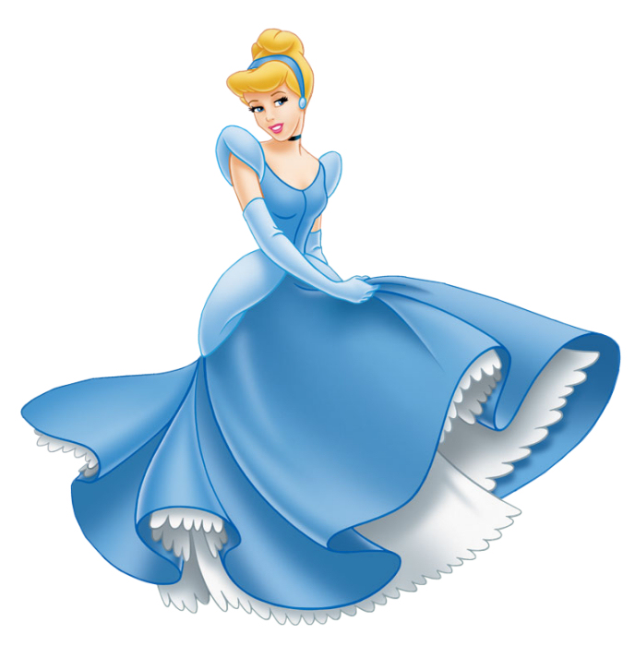
What do you remember about the story of Cinderella? Brainstorm a short summary.

Slide 3
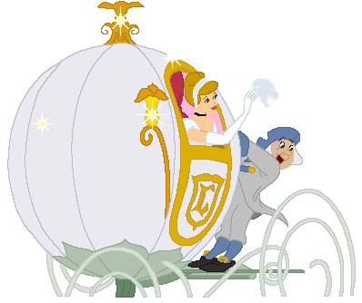
Level one questions
Can be answered explicitly by facts contained in the text
Finger facts—you can put a finger on the answer
Fully and clearly expressed
Leaves no doubt as to the right answer
There is only one right answer
What were Cinderella’s slippers made out of?
How did Cinderella get to the ball?

Slide 4
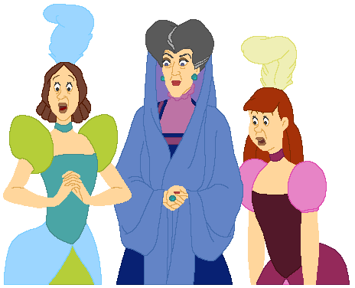
Level two questions
Textually implicit
Require analysis and interpretation
Ask how and why
Reading between the lines
More than one right answer
Deriving logical conclusions from known premises
Why does Cinderella’s step-mother care whether or not she goes to the ball?
Why did everything go back to the way it was except the glass slipper?
Why don’t the step-sisters like Cinderella?

Slide 5
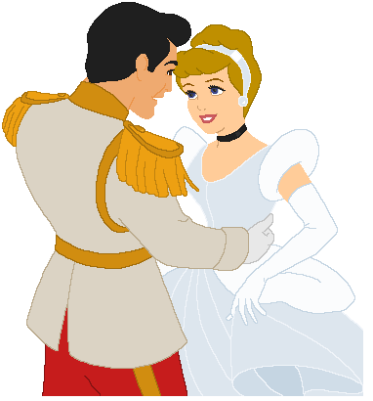
Level three questions
Open-ended
Go beyond the text
Provoke discussion of an abstract idea or issue
Can be answered with the text, another text, or life experiences
The characters’ names, book title, or plot details are NOT mentioned in the question; it is more universal.
What does it mean to live happily ever after?
Will good always overcome evil; why or why not?

Slide 6
WHAT LEVEL ARE THESE QUESTIONS?
1. What is the protagonist’s name?
2. What types of conflicts do people avoid in life?
3. How are the three small trees in this chapter symbolic?
4. What color was the balloon and is that significant?
5. Why do the girls hide the shoes at the end of the chapter? What emotion does it suggest?
6. What tone was used when Esperanza said, “I know how those things go”?
7. How old is Marin?
8. What similarities are there between Marin and Esperanza?
9. In what areas of life do we have the most freedom?
10. Why did Sally and the boys laugh at Esperanza, and what does that show about their different stages of maturity?

Slide 7
PRACTICE!
Make up ten study questions using the following types:
2 LEVEL ONE questions
6 LEVEL TWO questions
2 LEVEL THREE questions
**anything that mentions characters, plot, chapters, or specific content in the novel can’t be a level 3 question!

