Slide 1
Allusions
From I Know Why the Caged Bird Sings

Slide 2
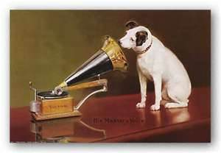
“All the Negroes around the world who sat sweating and praying, glued to their “Master’s voice.” (57)
The original painting was partially finished in 1898 by British artist Francis Barraud, who portrayed his brother's dog listening to "His Masters Voice" on an Edison cylinder phonograph that was placed on top of the coffin of his brother (the dog's master). It later became an advertising image for RCA phonographs (records).

Slide 3
“Ambrosia”
“ People drank Coca Cola like ambrosia. . . “ (58)
What is ambrosia?

Slide 4
Try researching the reference:
“In Greek mythology, ambrosia was a honey-flavored food eaten by the gods that allowed them to remain immortal. With the ambrosia, they often drank a honey-flavored drink called nectar. According to legend, each day doves brought ambrosia to Zeus, the king of the gods, to distribute among the other deities.”
http://www.mythencyclopedia.com/A-Am/Ambrosia.html

Slide 5
Another allusion . . .
“. . . That God himself hated us and ordained us to be hewers of wood and drawers of water, forever and ever, world without end.” (57)
Does the WORD CHOICE/DICTION sound familiar? Where might it come from?

Slide 6
Yes. . . . It is a biblical allusion
Hint: the language choices (diction) of “ordained” and “hewers” plus “forever and ever” give hints that the wording is modeled after something religious.
Do internet searches of quotes for allusions if you think something is a reference, but you aren’t sure of the original source.
SOURCE: Joshua 9
The Hivites deceived the Israelites into making a pact with them, even though God had told the Israelites to kill them. The Israelites instead disobeyed God and made the Hivites their SLAVES, people who would chop wood and carry their water.

Slide 7
Joshua 9: 23
“Now therefore ye are cursed , and there shall none of you be freed from being bondmen, and hewers of wood and drawers of water for the house of my God.” (KJV)
Connect this allusion to “Champion of the World.” What comparison is Angelou making between the black people and the Hivites in Joshua 9?

